Slide 1
Emergency Resource Allocation (E.R.A.) Website
Jose Martinez
CSCI 4390
Advisor: Dr. Emmett Tomai

Slide 2
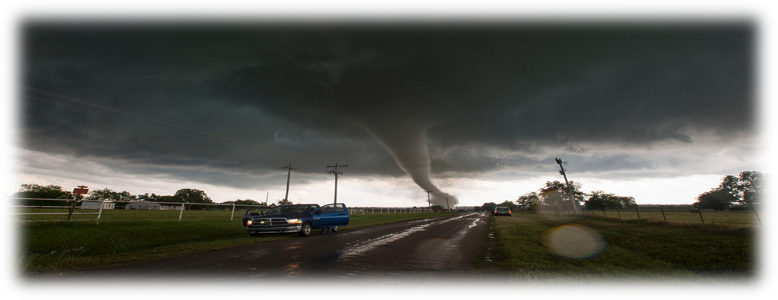
Motivation
Natural disasters occur several times a year and always leave a trail of wreckage and confusion
To help speed up the reaction and recovery time of an area immediately following a natural disaster.
With a clear view of what materials are being demanded in regions, resources can be allocated where they are needed the most, thus reducing surplus supplies and prioritizing help where it imperative

Slide 3

Motivation

Slide 4
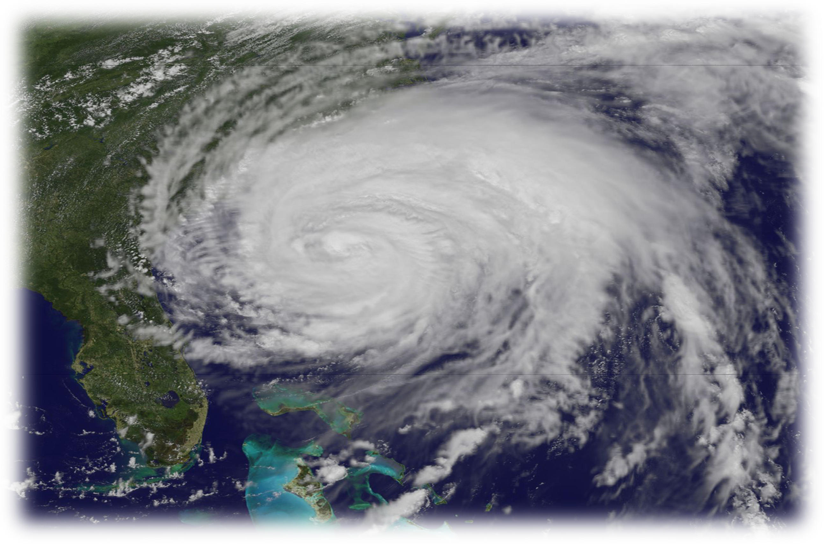
Goals
The overall goal of the Emergency Resource Allocation (ERA) Website is to create a website that can help gather, organize, and display resource data in the event of a disaster.
Government users should be able to clearly see which areas need which resources.
Efficiently organize data and display it effectively.

Slide 5


Implementation
Programming Environment
Ruby on Rails – full framework programming environment
Utilizing bootstrap gem
Running it from the console
Utilizing Notepad as text editor

Slide 6
Three kinds of users
Admin User *All can edit their
See some information from all other users own profiles
Create/Delete disaster pages
Create/Delete new organizations
Government level users
Create/Delete disaster pages
View all resources for their disaster pages
Civilian users
View disaster pages in their state
Create/delete resources

Slide 7
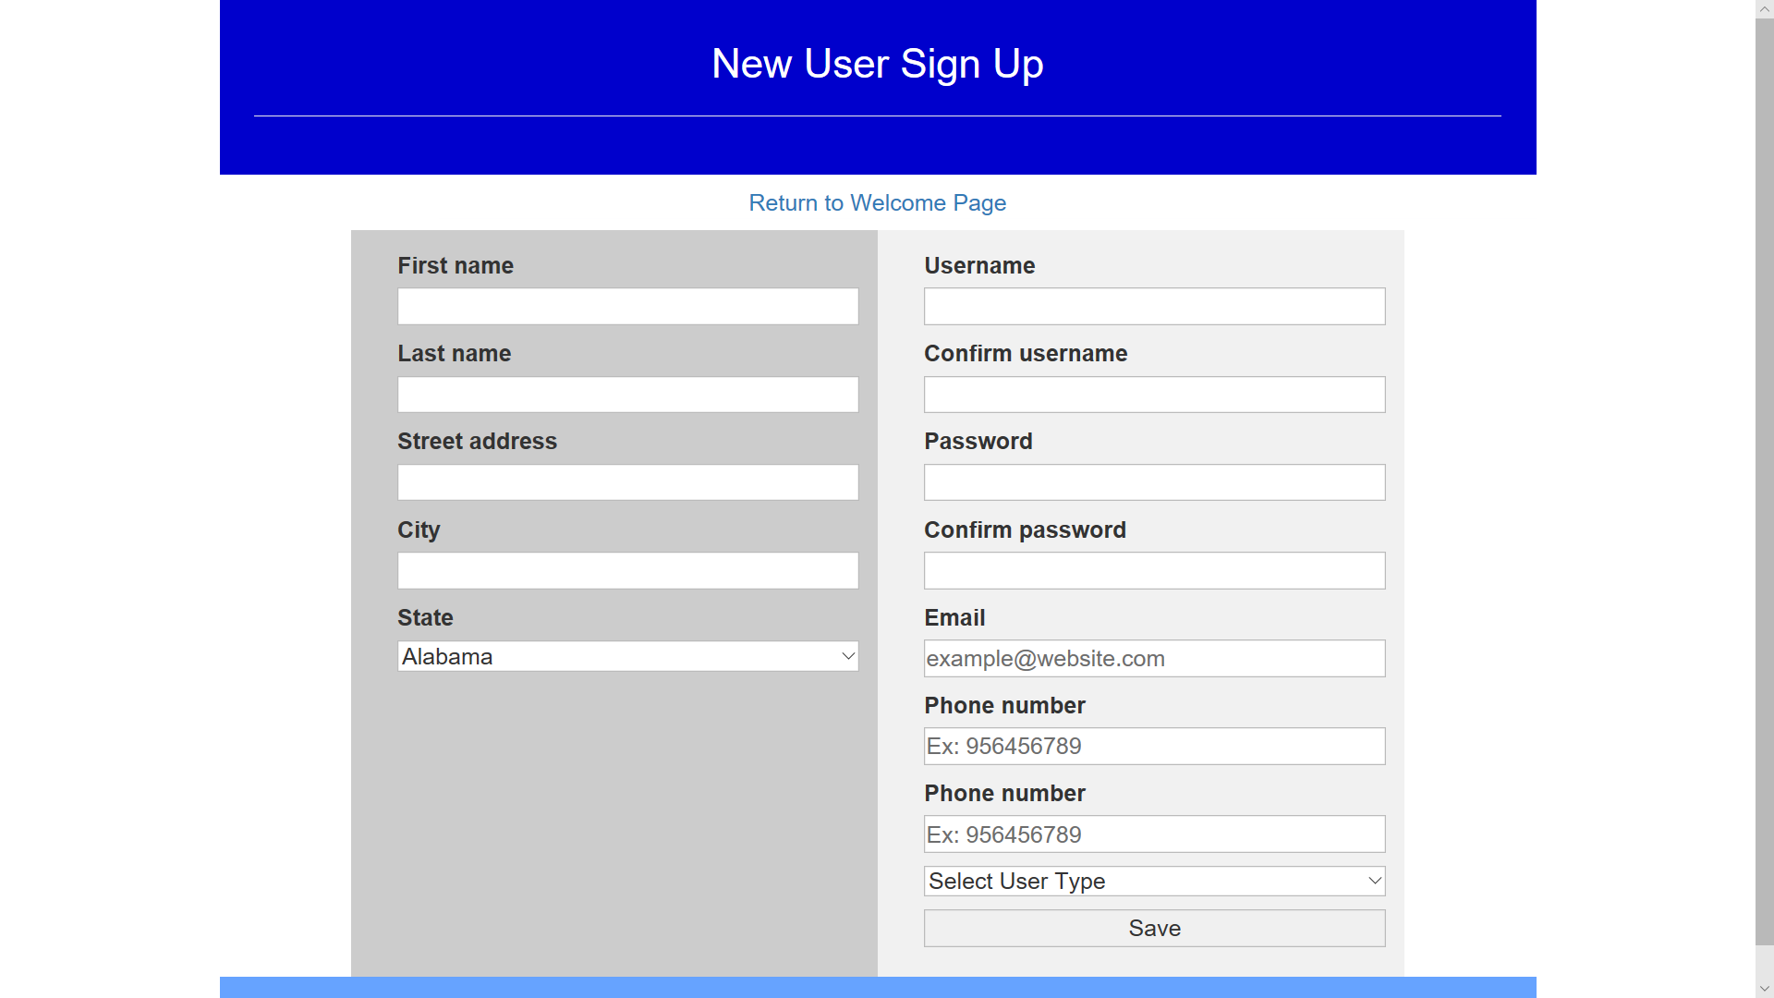
Implementation- Sign-up page
All users sign up at same location

Slide 8
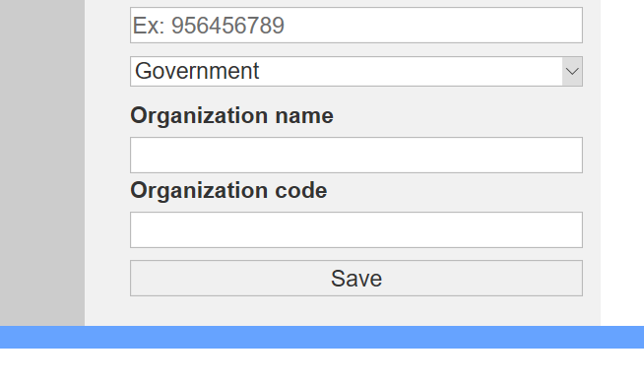
Implementation- Sign-up page
Government users must enter the name of the organization they belong to and a verification code
These fields are set up by Admin level user, then distributed by the organization amongst its employees

Slide 9
Implementation- User and Resource Databases
organizations
orgname
orgcode
created_at
updated_at
govtusers
first_name
last_name
address
city
state
username
email
phone_number
created_at
updated_at
password_digest
usertype
orgname
orgcode
How they relate to each other
Foreign Key
Disasterevents
name
begindate
disaster_type
state
description
created_at
updated_at
madeby
resourceitems
resourcename
resourcedescription
quantity
city
disasterevent_id
created_at
updated_at
madeby
currstatus
askedfor

Slide 10
Demo

Slide 11
Conclusion
Learning to use ruby on rails was the most important step to completing the website
What's so good about Ruby on Rails? Why should I learn it?

Slide 12




Why Learn Ruby on Rails?
Rails is a full stack framework
Ruby is easy to learn with intuitive commands
Rails has a large library that provides helpful gems for making development quick and easy
Ruby on Rails is also used by websites like:
Airbnb
Twitch
Shopify
gitHub

Slide 13
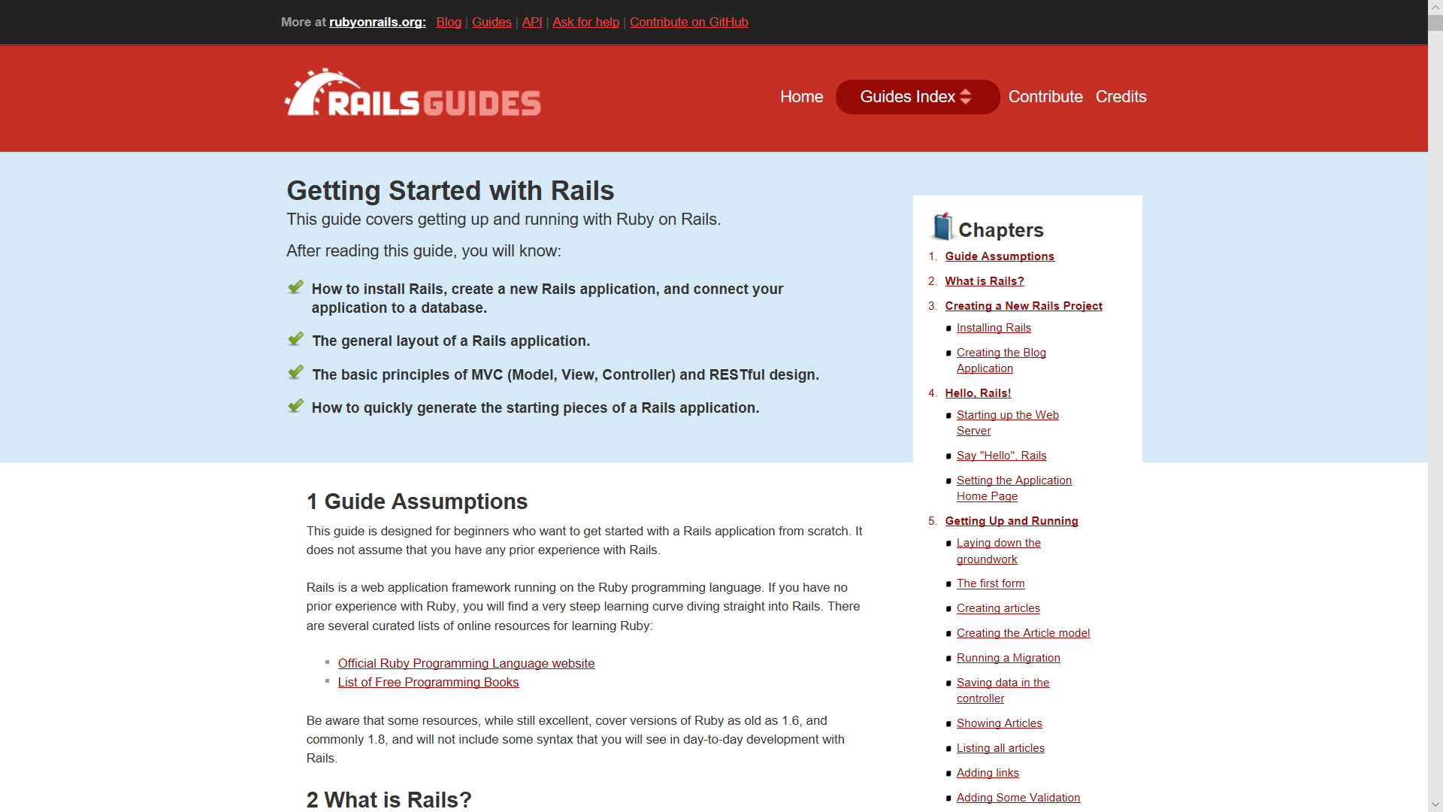
Recommended Resources
A webpage that will guide the user through a blog webpage setup:
https://guides.rubyonrails.org/getting_started.html#installing-rails

Slide 14
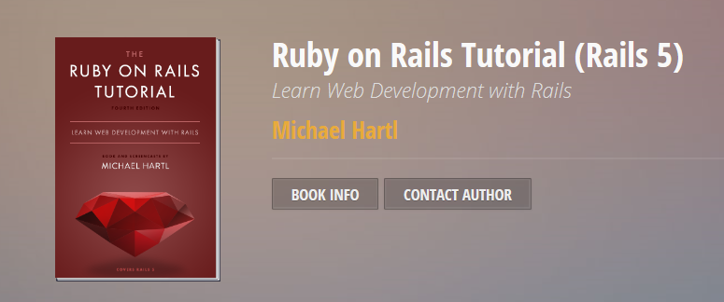
Recommended Resources
A free online book that covers a Ruby on Rails tutorial in great detail can be found by searching for: Learn Web Development with Rails

Slide 15
Future Implementations:
The implementation of google maps to improve the location of resource need accuracy.
The prediction of which resources will be needed once a disaster has been declared,
predictions would use the maps data to determine possible quantities of resources while data from previous disasters can help determine which items will be needed.
Estimate total cost of reported damage
Assign a price tag to each resource type or access some database from a contributing store (like HEB) and calculate the total cost of the resources needed.

Slide 16
End

